Slide 1
NBA Shiny Data Exploratory
Werner Chao
March 11, 2017

Slide 2
Outline
Introduction
Motivation
Hypothesis
Data Exploratory
Seasonal Shot Usage %
Season Average Shot Distance
Offensive Rating
Offensive Rating vs. Shot Usage %
Offensive Rating vs. ?
Conclusion
Predict Offensive Rating

Slide 3
Outline
Introduction
Motivation
Hypothesis
Data Exploratory
Seasonal Shot Usage %
Season Average Shot Distance
Offensive Rating
Offensive Rating vs. Shot Usage %
Offensive Rating vs. ?
Conclusion
Predict Offensive Rating

Slide 4
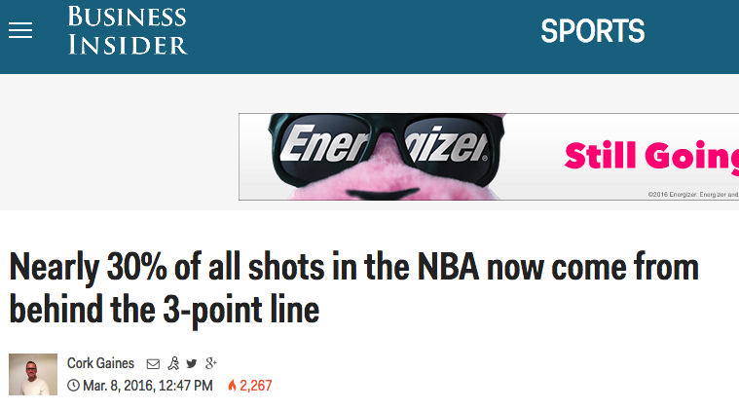
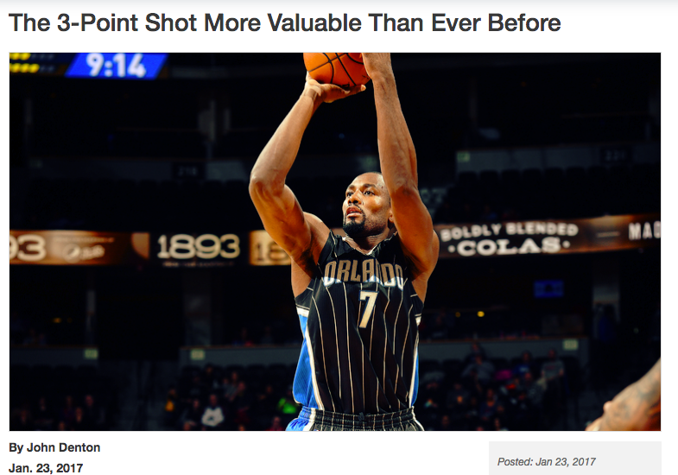
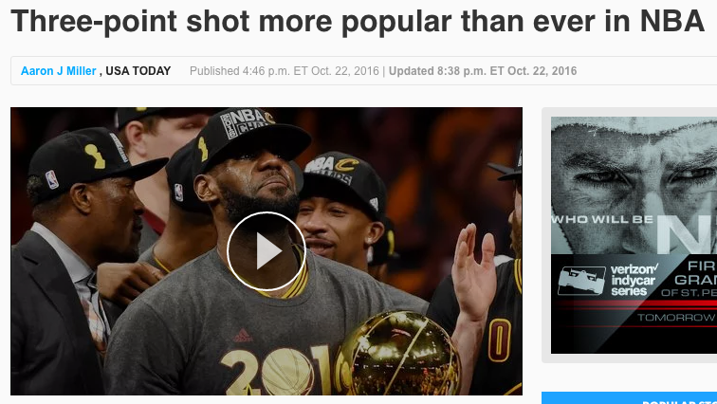
Motivation – The Hype

Slide 5
Hypothesis
Do winning teams take more 3 point shots?
Do winning teams take less short ranged shots?
Have all the teams shifted to long range shooting strategy?
Are there teams getting left behind because they didn’t adapt?
Are 3 point shooting as effective as the hype says?
How effective comparing 3 point vs 2 point shots?

Slide 6
Outline
Introduction
Motivation
Hypothesis
Data Exploratory
Seasonal Shot Usage %
Season Average Shot Distance
Offensive Rating
Offensive Rating
Offensive Rating vs. Shot Usage %
Offensive Rating vs. ?
Conclusion
Predict Offensive Rating

Slide 7
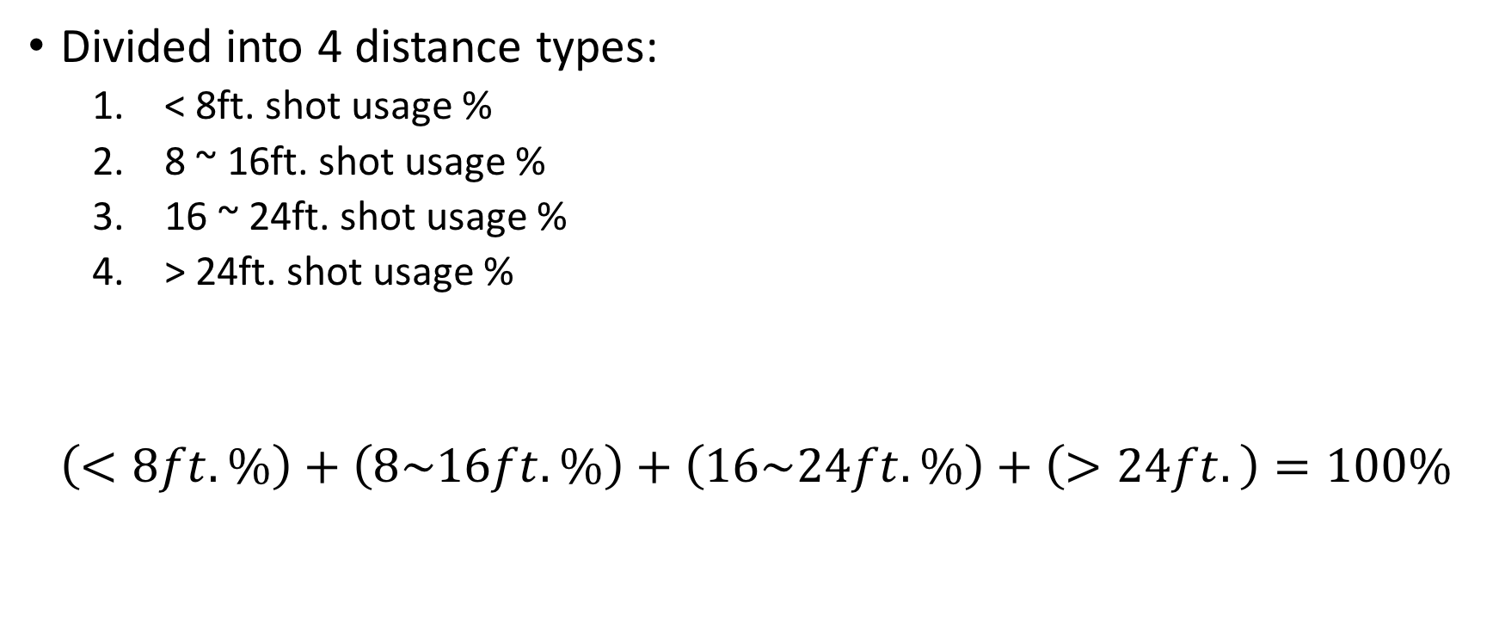
Seasonal Shot Usage %
Divided into 4 distance types:
< 8ft. shot usage %
8 ~ 16ft. shot usage %
16 ~ 24ft. shot usage %
> 24ft. shot usage %
$$\left(<8ft. \%\right)+\left(8\sim 16ft. \%\right)+\left(16\sim 24ft.\%\right)+\left(>24ft.\right)=100\%$$

Slide 8
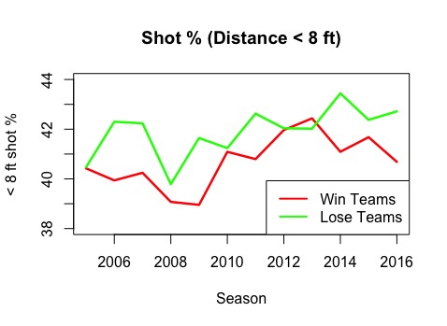
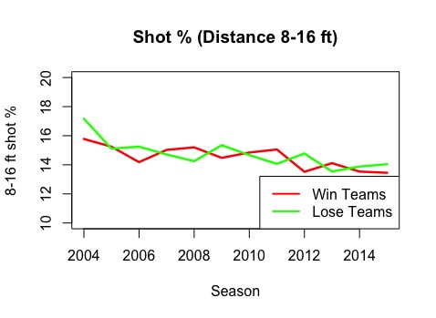
Seasonal Shot Usage %

Slide 9
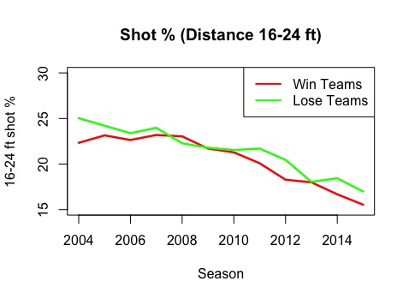
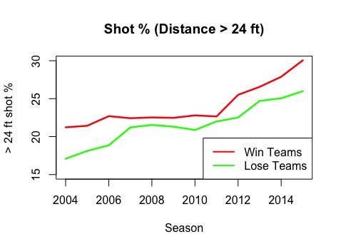
Seasonal Shot Usage %

Slide 10
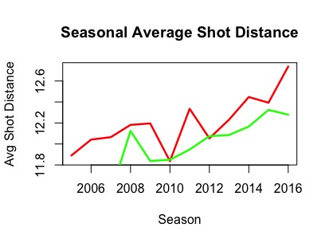
Seasonal Avg. Shot Distance

Slide 11
Hypothesis
Do winning teams take more 3 point shots?
Do winning teams take less short ranged shots?
Have all the teams shifted to long range shooting strategy?
Are there teams getting left behind because they didn’t adapt?
Are 3 point shooting as effective as the hype says?
How effective comparing 3 point vs 2 point shots?
Answer:
Teams got into playoff definitely take
more long range shots
less short range shots

Slide 12
Hypothesis
Do winning teams take more 3 point shots?
Do winning teams take less short ranged shots?
Have all the teams shifted to long range shooting strategy?
Are there teams getting left behind because they didn’t adapt?
Are 3 point shooting as effective as the hype says?
How effective comparing 3 point vs 2 point shots?
Answer:
All teams are adapting and taking longer range shots
All teams are sacrificing 16~24ft range for 3 point shots

Slide 13
Hypothesis
Do winning teams take more 3 point shots?
Do winning teams take less short ranged shots?
Have all the teams shifted to long range shooting strategy?
Are there teams getting left behind because they didn’t adapt?
Are 3 point shooting as effective as the hype says?
How effective comparing 3 point vs 2 point shots?

Slide 14
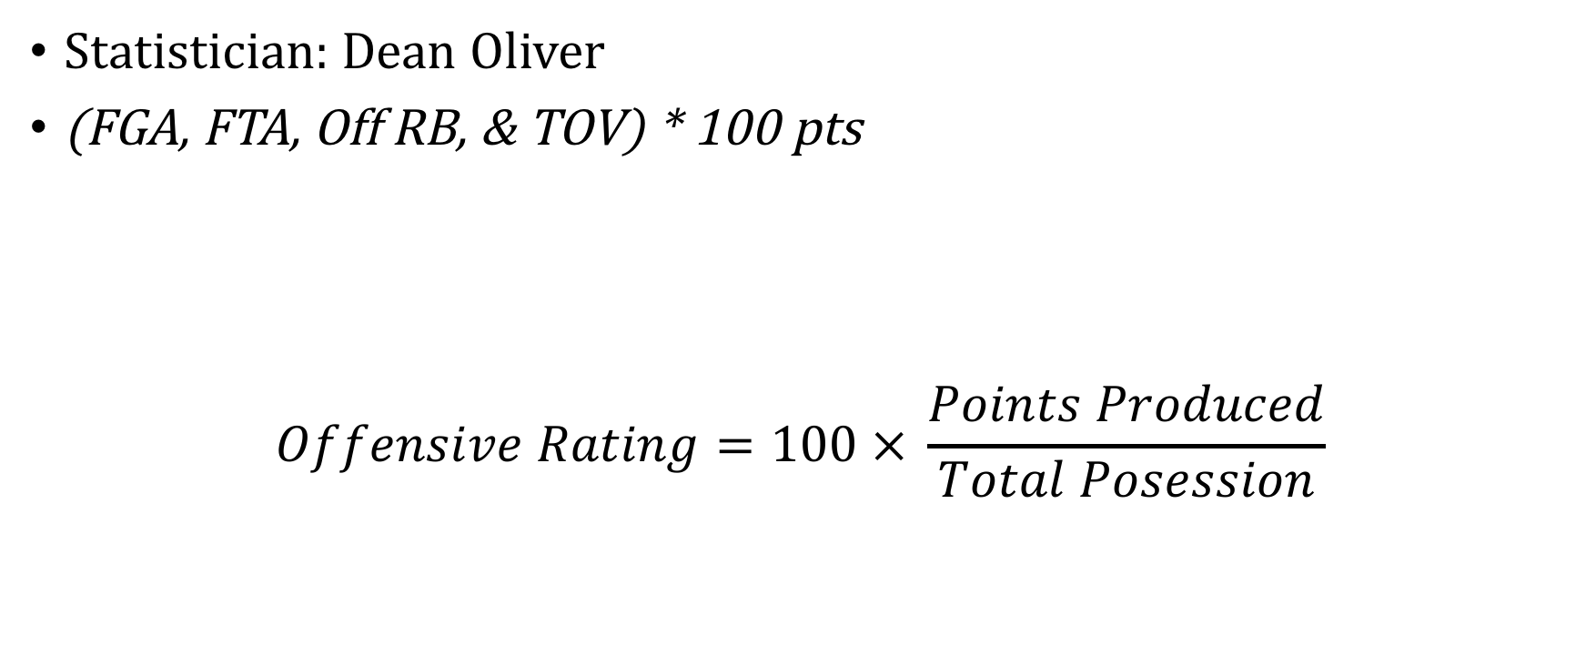
Offensive Rating
Statistician: Dean Oliver
(FGA, FTA, Off RB, & TOV) * 100 pts
$$Offensive Rating=100 × \frac{Points Produced}{Total Posession}$$

Slide 15
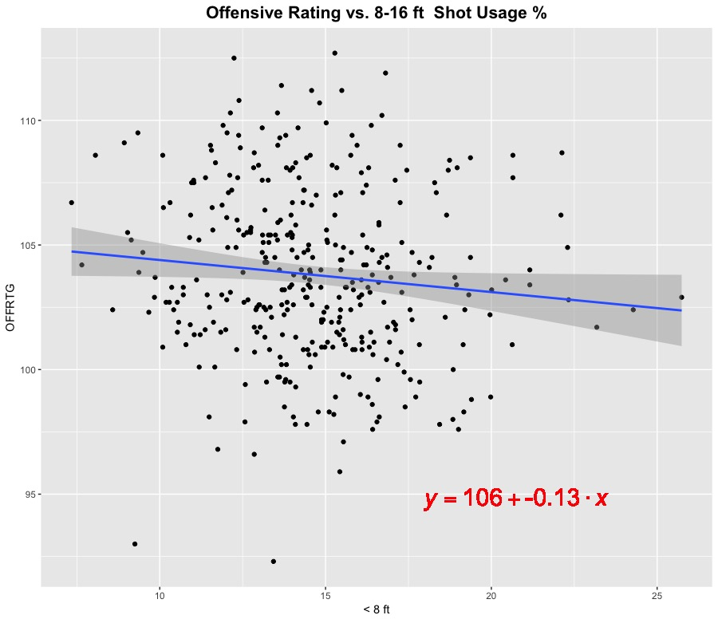

Offensive Rating vs. Shot Distance Usage

Slide 16
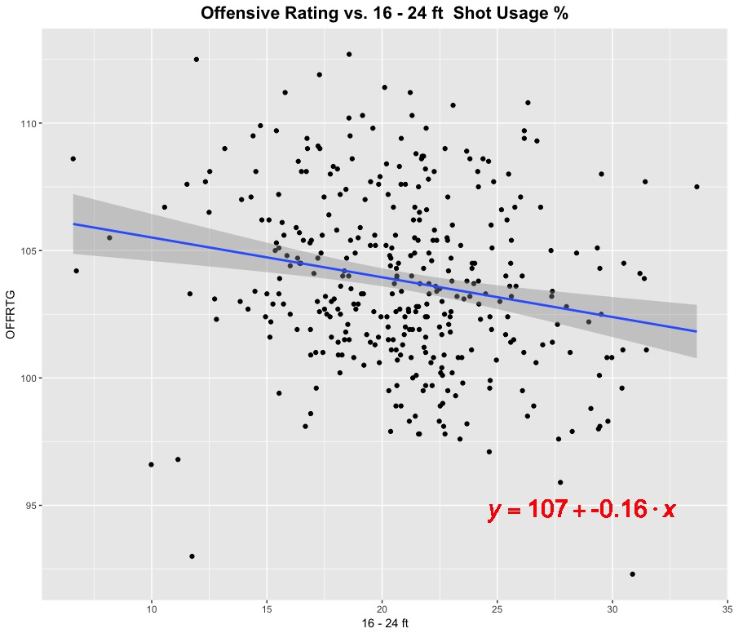
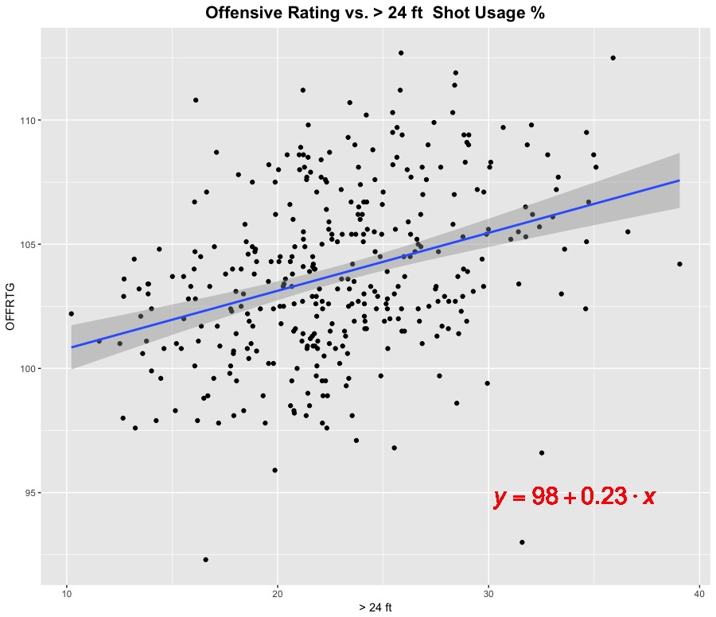
Offensive Rating vs. Shot Distance Usage
Positive Slope, BUT
very small

Slide 17
Offensive Rating vs. ?
The previous variables were not good predictors for offensive rating
i.e. 3pt. shot usage % alone does not tell us how well we will do in offensive rating
Need new variables → how about shot combos?
Would the combination of (3pt shot + layup) tell us how well we will do in offense?
3 combinations here:
3pt shot + 16-24ft shot
3 pt shot + 8-16ft shot
3 pt shot + < 8ft shot

Slide 18
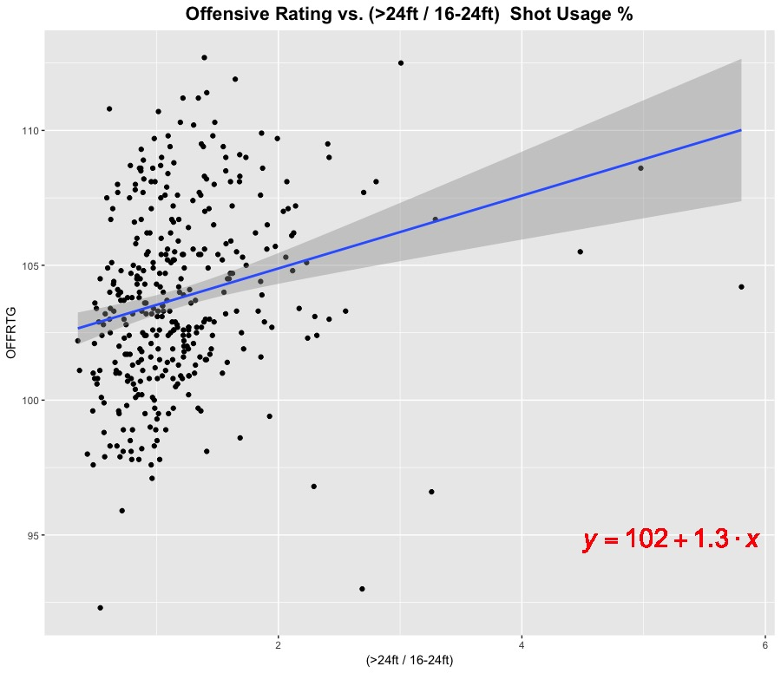
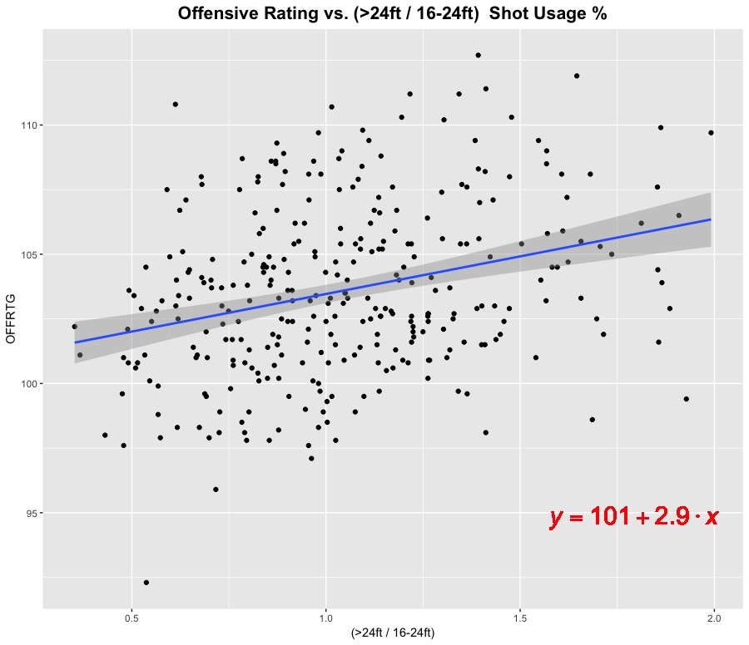
Offensive Rating vs. Shot Combinations
Clean up anomalies

Slide 19
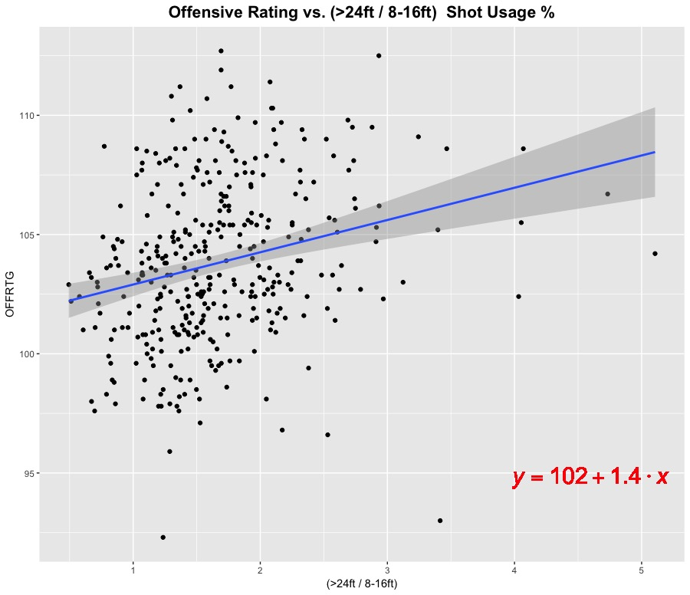
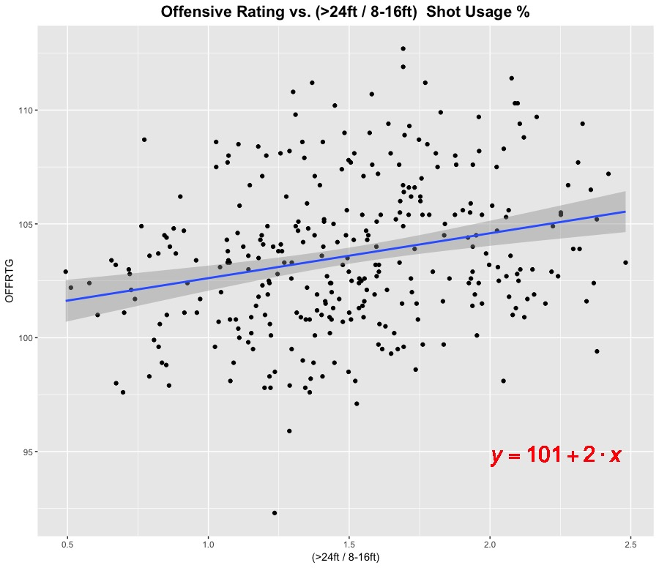
Offensive Rating vs. Shot Combinations
Clean up anomalies

Slide 20
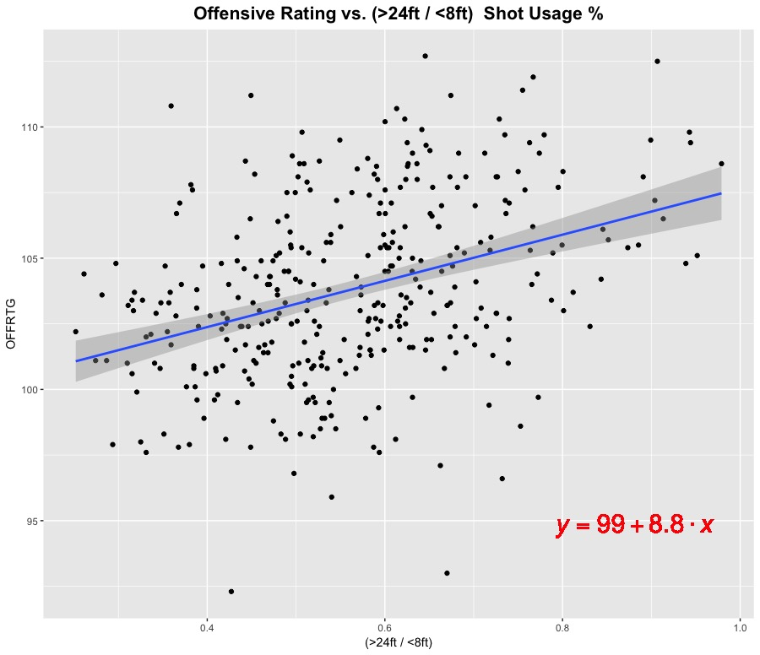
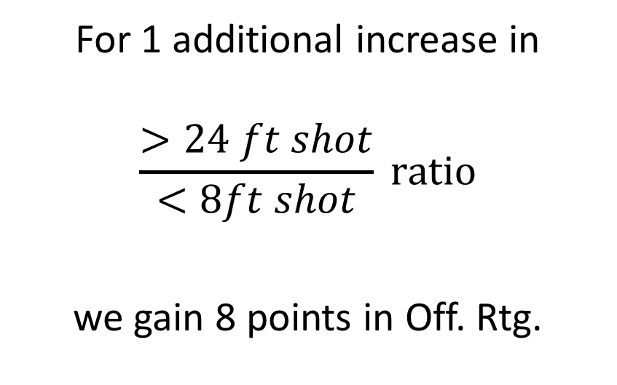
Offensive Rating vs. Shot Combinations
For 1 additional increase in
$$\frac{>24 ft shot}{<8ft shot} ratio$$
we gain 8 points in Off. Rtg.

Slide 21
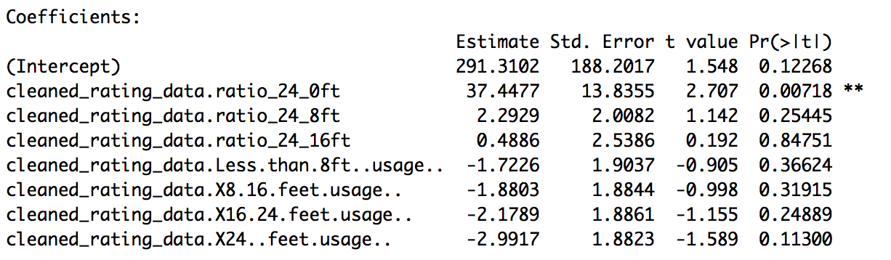

Linear Model Fit
The variable, ($\frac{>24 ft shot}{<8ft shot} ratio)$, has a p-value of: 0.00718
In English: we are 99.282% confidence this variable will tell us how well we do in offense
And, the higher this ratio is, the better we do offensively

Slide 22
Seasonal Shot Usage %

Slide 23
Hypothesis
Do winning teams take more 3 point shots?
Do winning teams take less short ranged shots?
Have all the teams shifted to long range shooting strategy?
Are there teams getting left behind because they didn’t adapt?
Are 3 point shooting as effective as the hype says?
How effective comparing 3 point vs 2 point shots?
Answer:
3 point shot is the most effective shot choice
Insight:
We might reconsider which range to sacrifice for 3 pt. shot

Slide 24
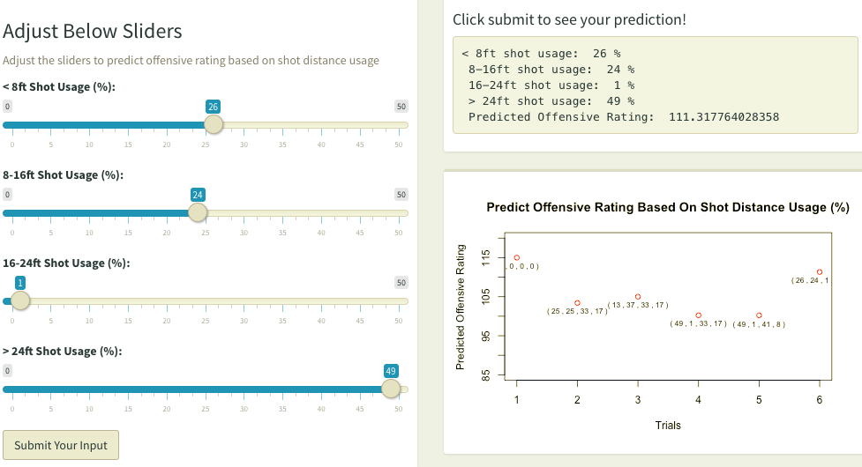
Conclusion
The hype is real
3 point shots are over underestimated before
More 3s is better
All teams are adapting
Losing teams are not
shooting enough
Might reconsider the
shot combination ratio
https://wernerchao.shinyapps.io/shiny_proj/

Slide 25
Questions?

